Slide 1
Traumatic Brain Injuries
Cathryn Nelson
Neuroscience Capstone 2010

Slide 2
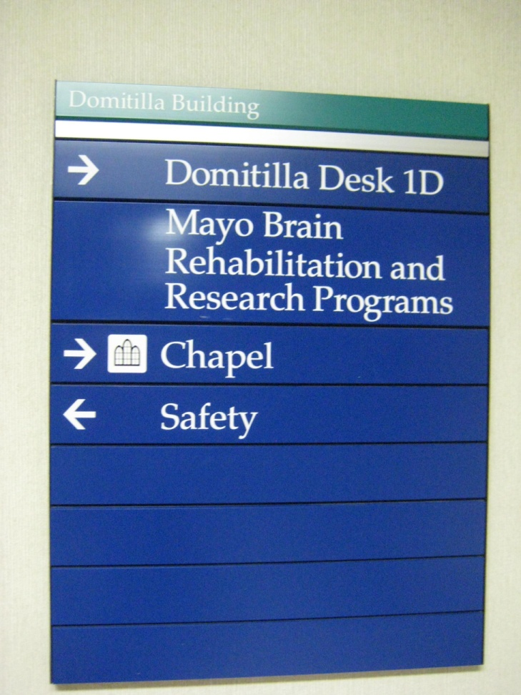
Traumatic Brain Injuries
Affect between 1 and 1.5 million people in the United States each year.
Often results in
expensive hospitalization
Notes:
Have them guess most common causes

Slide 3
Three Common Types of damage resulting from Traumatic Brain Injuries
Diffuse Axonal Injury-
Contusion
Subdural Hemorrhage

Slide 4
Three Common Types of damage resulting from Traumatic Brain Injuries
Diffuse Axonal Injury- Tearing or twisting of neuronal axons resulting in damage to neurons
Contusion
Subdural Hemorrhage

Slide 5

Diffuse Axonal Injury

Slide 6
Three Common Types of damage resulting from Traumatic Brain Injuries
Diffuse Axonal Injury
Contusion- Bruising of the Brain
Subdural Hemorrhage

Slide 7

Contusion

Slide 8
Three Common Types of damage resulting from Traumatic Brain Injuries
Diffuse Axonal Injury
Contusion
Subdural Hemorrhage- Bleeding from the brain due to ruptured blood vessels

Slide 9
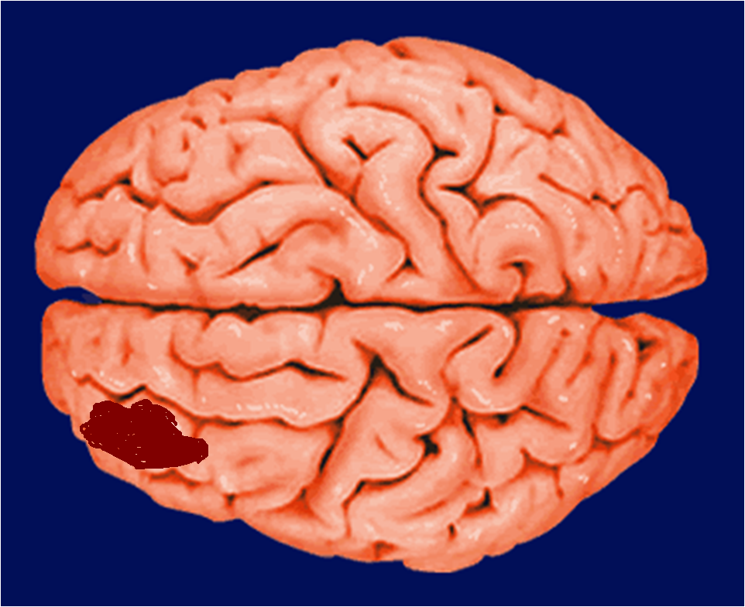
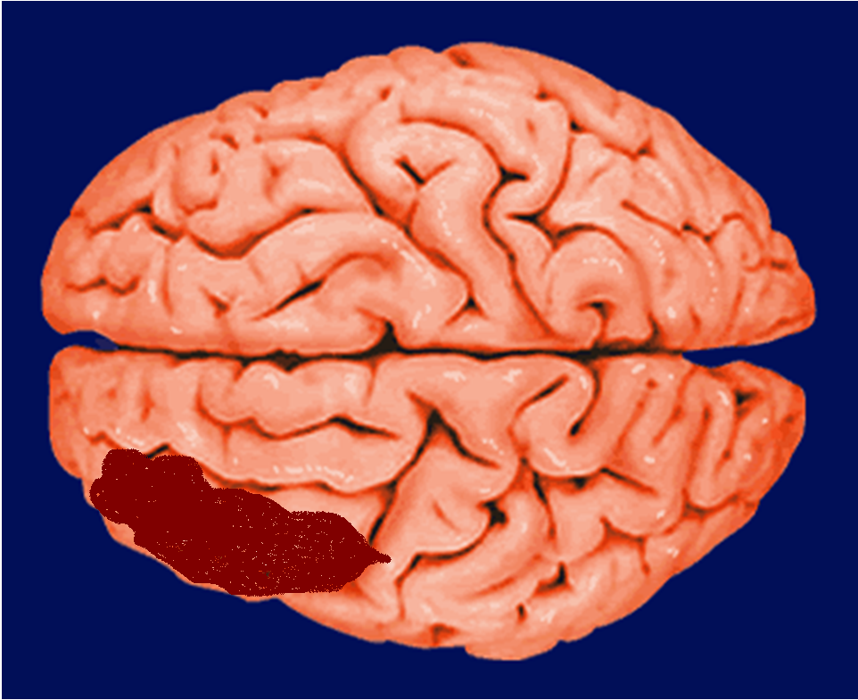
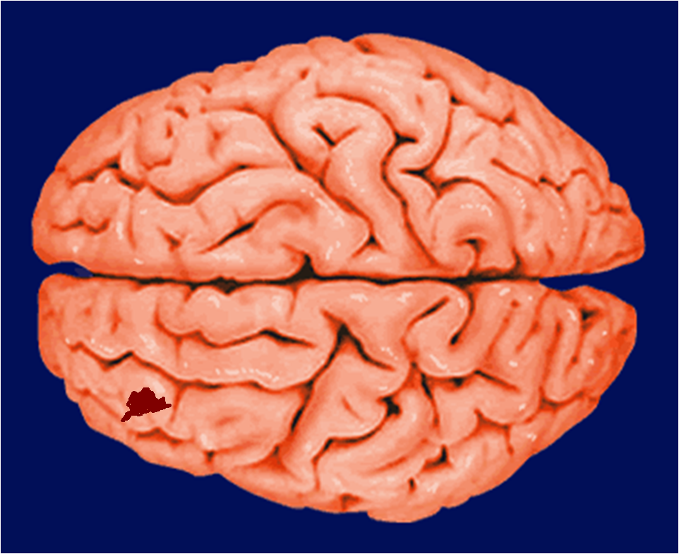
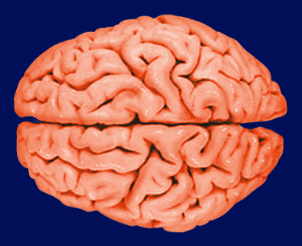
http://www.morphonix.com/software/education/science/brain/game/specimens/images/wet_brain.gif

Slide 10
Complexity of Traumatic Brain INjuries
Each Traumatic Brain Injury is Unique.
Treatment is challenging because each individual has different needs and impairments.
Often the brain is injured at more than one site.

Slide 11
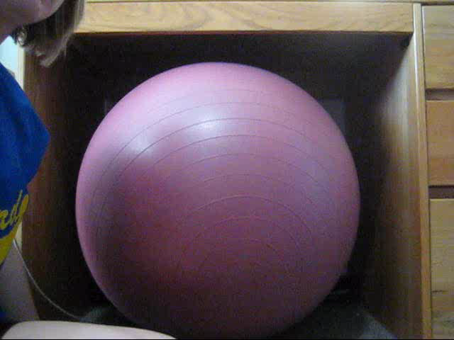
The Brain often impacts the skull in more than one area.
This widespread damage can cause a variety of negative symptoms

Slide 12
Common Consequences of TBI
Emotional Disturbances
Memory Loss
Cognitive Impairments
Headache
Loss of job
Divorce

Slide 13
There is Hope!
With Occupational, Speech and Physical therapy, TBI patients can recover a lot of functioning.
With help from a Psychologist or Counselor, patients and family members can learn to cope with the patient’s “new normal”.

